Slide 1

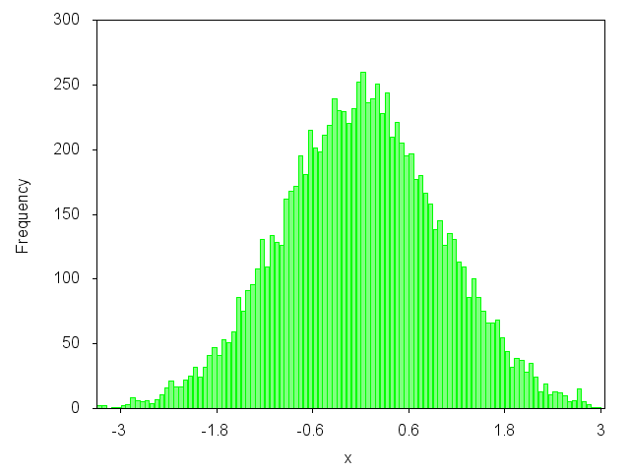
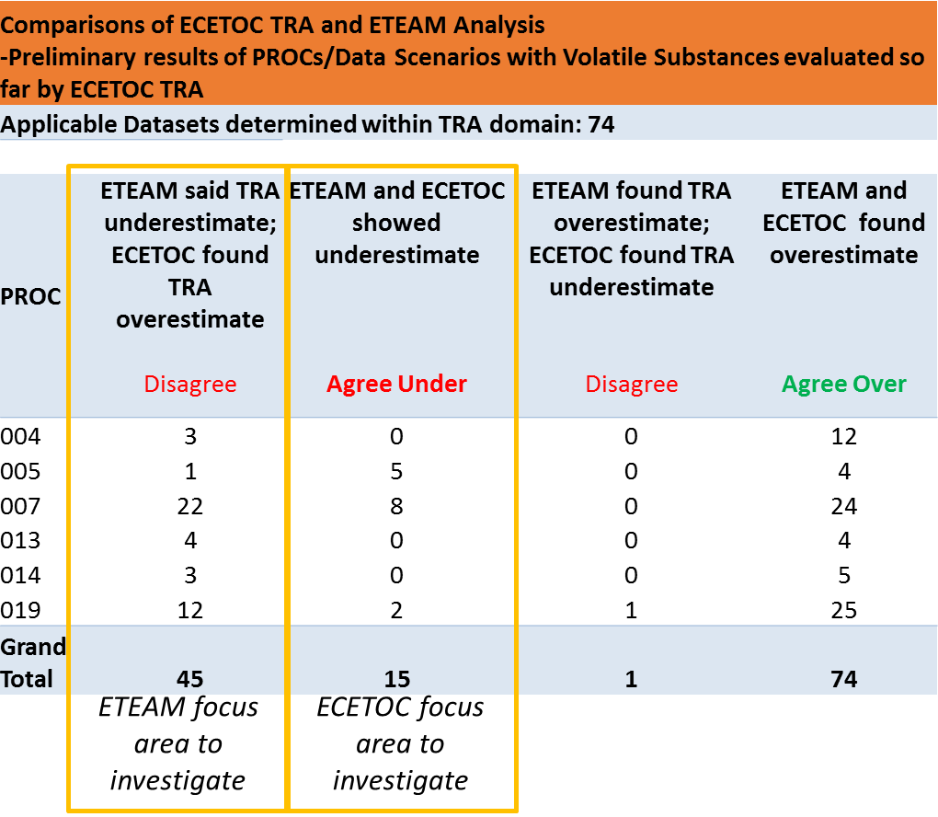
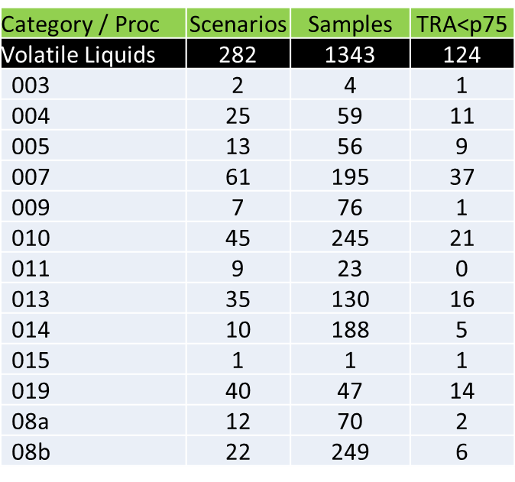
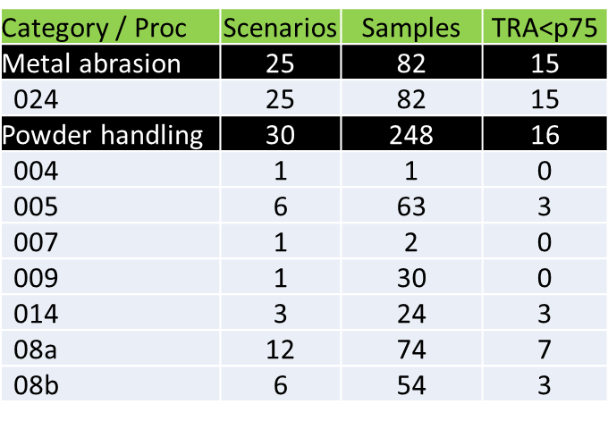

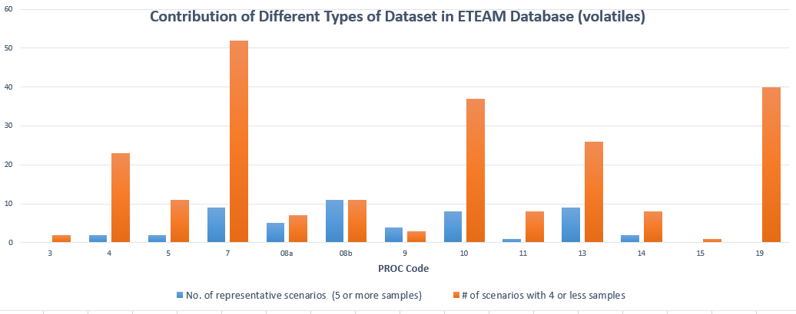
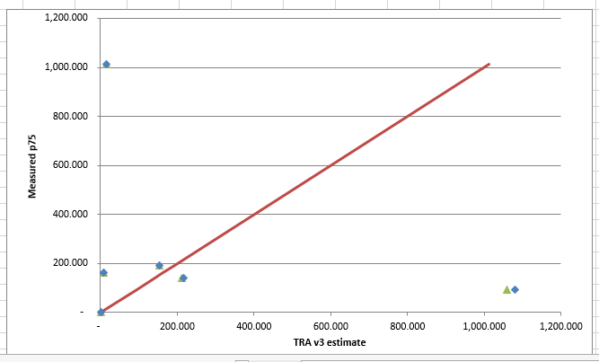
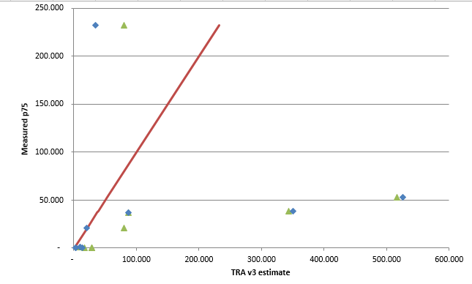
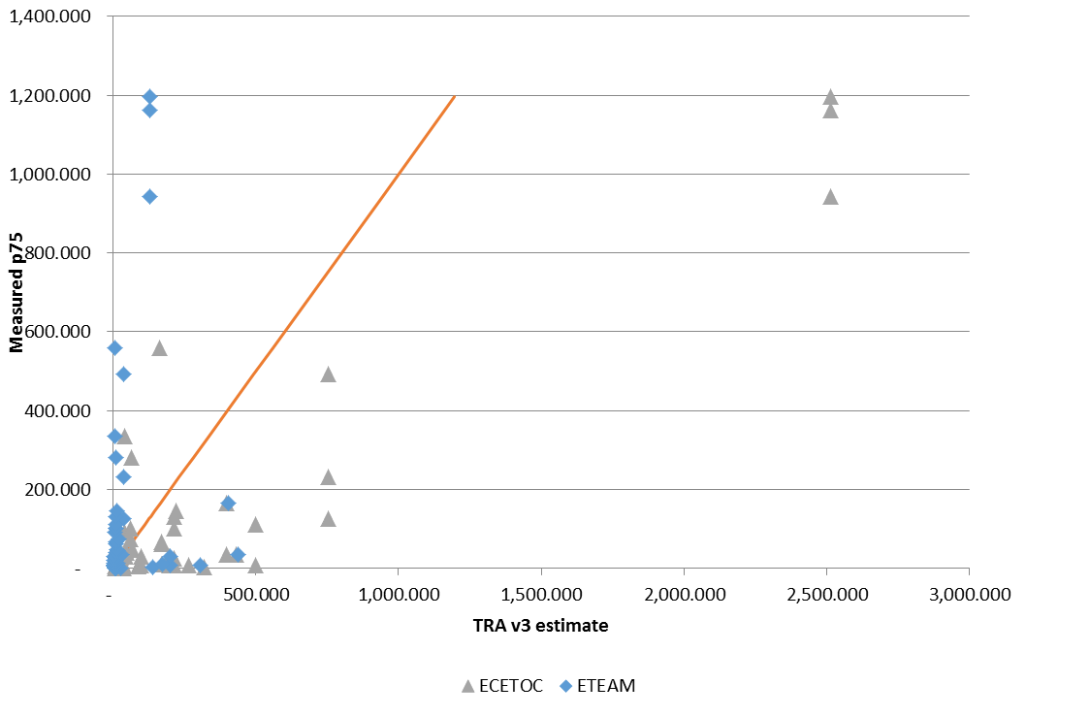
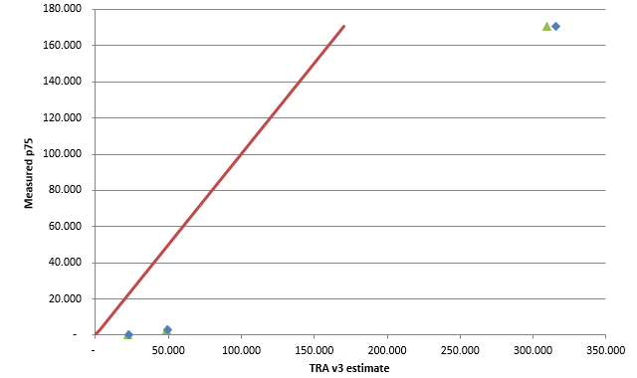
Re-analysis of the ETEAM Database for the ECETOC TRAv3 Model
Barone N¹, Bachler G², Keller D³, Money C⁴, Noij D⁵, Tibaldi R¹
¹ExxonMobil Biomedical Sciences, Inc., Annandale, New Jersey, U.S.
²Shell Health, Shell International B.V., The Hague, The Netherlands.
SC218 / Agenda Item 6f
Background
Results
Overall Findings
Concordance of ETEAM and ECETOC Findings
In 2015 the ETEAM study (BAuA, 2015) sought to evaluate the performance of a range of Tier 1 REACH worker exposure models.
The underlying data base and assumptions used to derive the exposure estimates for validation are now available.
ECETOC took the opportunity to examine the ETEAM database with the aim of identifying the extent to which the ETEAM findings could help inform on revisions that might be implemented to improve the reliability of the TRA worker exposure estimates.
ETEAM database contains 1673 sample data points
  These derive from 337 datasets
  Of the 337 datasets, 45 contain 4 or more samples
  only 24 with ≥ 6 data points
Of the 337 datasets, 282 relate to volatile substances, 30 to powder handling and 25 to metal abrasion
Experienced REACH workplace exposure assessors reviewed 184 scenarios
  27% were judged to be outside the domain of the TRA.
  Agreed with the ETEAM allocations in 89 cases
  Disagreed with ETEAM allocations in 46 cases
  In 45 cases the revised TRA estimates were higher than the original ETEAM predictions
  1 case where the revised TRA estimates were lower than the original ETEAM predictions
ETEAM database sufficient information to enable the re-construction of the ETEAM estimates
Found ETEAM Methodology for TRA data validation problematic
  Individual measurements in ETEAM db found for same scenario and substance sampled
  TRA provides a P75 exposure prediction for a work group activity
  ETEAM data in some cases required aggregation to derive 75th percentile values
  ETEAM attempted to use the TRA to derive P75s for individual workers
  The ETEAM analysis should have proceeded based on a comparison of TRA estimates against relevant datasets for work group activities
For many scenarios, the use and exposure descriptors were inappropriately chosen
  Particularly PROCs and LEV assumptions
  Duration assigned often does not match db contextual information
Consensus-based approach best for Use Descriptor decisions
Example: PROC assignment; LEV present; duration rationale
75th %
Objectives
ECETOC concerns on findings led to following questions for investigation:
Are we able to accurately re-construct the ETEAM and MEGA estimates?
Does the database contain sufficient contextual information ?
Do the scenarios cover situations considered to be covered within the domain of the TRA?
Have correct Use Descriptors been applied to develop the TRA estimate? e.g. those described in Use Maps
Are the methods of analysis adopted by the ETEAM appropriate for the TRA?
Are the ETEAM estimates ‘accurate’?
What changes are needed to improve TRA?
Conclusions
Many instances found datasets have few samples and not sufficiently robust to draw critical conclusions.
Concerning its application to the TRA, the basis for the original ETEAM analyses are not appropriate
Include datasets that the TRA was never intended to apply to
The ETEAM database would appear to contain a significant percentage of cases where REACH Use Descriptors have been incorrectly applied
This materially affects the integrity of the database and the nature of the associated ETEAM findings
The nature of how the database was compiled results (for certain PROCs) in a few datasets potentially influencing the nature of the findings
No ‘test’ applied of whether these datasets can be considered representative
An updated analysis that accounts for these issues indicates that although the TRA may underestimate exposure for some PROCs, it is less severe than suggested by the ETEAM
  Although the number of underlying datasets on which these findings are based is limited
  PROC 7 shows highest percentage of underestimation
ECETOC will continue to review new information that is relevant to ensuring the TRA remains accurate and fit-for-purpose for use under REACH
  Discuss findings with ETEAM investigators
  Explore options to gain additional measurement data
Develop 2017 plans for future TRA update
Scope of the Database
Specific Findings
Method
PROC 10
ETEAM analysis included data outside TRA applicability domain
notably some CMRs, pharmacologically active drugs and ‘potent’ agrochemicals
These are retained in the updated analysis where they conform to TRA ‘rules’ e.g. reasonable basis for assuming the TRA can be used to predict exposures
Updated analysis indicates that TRA may underestimate exposures for some scenarios
But magnitude and frequency is less than ETEAM
ECETOC Scientific Committee decision for re-analysis in March 2016 and TRA working group (WG) formed.
ETEAM access database converted into user friendly Excel to improve data analysis transparency. Parameters included:
  scenario information
  sample information
  ETEAM TRA input variables and TRA exposure estimates
  sample data
  number of samples for each scenario (N)
  minimum (MIN), maximum (MAX), arithmetic mean (AM), geometric mean (GM), geometric standard deviation (GSD)
  75th percentile of sample data distribution (P75)
TRA WG limited initial analysis focused on:
  volatile substance data (Powder handling and metal abrasion scenarios too limited)
  PROCs 4, 5, 7, 13, 14, and 19
  Compared relevant ETEAM datasets and single data points to TRA 75th percentile estimates
Scenarios allocated by PROC to 4 teams of experienced REACH worker exposure assessors
Judgments and comments of assessors recorded and consolidated
Comparisons of ETEAM decisions and TRA WG alternate judgments analyzed
Applicability of the Database to the TRA
ETEAM Data within ECETOC TRA applicability domain Phase: Volatile Liquid
PROC | Yes | No | ND | Total
003 |  |  | 2 | 2
004 | 15 | 10 |  | 25
005 | 10 | 3 |  | 13
007 | 54 | 7 |  | 61
009 |  |  | 7 | 7
010 |  |  | 45 | 45
011 |  |  | 9 | 9
013 | 8 | 27 |  | 35
014 | 8 | 2 |  | 10
015 |  |  | 1 | 1
019 | 40 |  |  | 40
08a |  |  | 12 | 12
08b |  |  | 22 | 22
Grand Total | 135 | 49 | 98 | 282
PROC 13
  ECETOC TRA reviewed selected PROCs 4, 5, 7, 13, 14, and 19
Assessed if the TRA model input prarameters selected aligned with contextual information given for scenario.
Aim was to determine if TRA parameters appropriately coded based on consensus approach.
Looked at how measured data and sample sets were analzed by ETEAM and power of study.
Next Steps
PROC 7
PROC 8a
References
BAuA, 2015, Evaluation of Tier 1 Exposure Assessment Models under REACH (eteam) Project (see http://www.baua.de/en/Publications/Expert-Papers/F2303-D26-D28.html )
ND = not determined or reviewed yet by ECETOC TRA
Notes:
Figure 3, shows how a library of GES templates were organized for each use by volatility and DNEL risk bands.
Seems odd for risk assessment purpose used the Carrillo 2014 paper for NOAEL to get 3950 mg/m3 but SCOEL 2007 use Lundberg 1995 for NOAEL >540 mg/m3?
Uses are organized to assess the life cycle of the substance from manufacture and formulation, through to various downstream uses. Each use may be comprised of 2 to 27 specific task based health risk assessment. (ie. termed component scenarios).

